Slide 1
The Right Stuff Literature Circles
Chapters 1 & 9
COM 1102
Spring 2022

Slide 2
Setting
Chapter 1.
The setting of chapter one is the Jacksonville naval air station. The specific locations of the characters shift often throughout the first chapter from the Conrad residence to funerals and the bogs.
Chapter 9.
The setting of the chapter nine is Cape Canaveral, Florida at the NASA complex. The settings shift between the NASA complex and the Russian space program. The setting then moves into the preparations for Shepards launch.

Slide 3
Rising and Falling Action for the Plot
Chapter 1
This chapter begins intense since the as soon as the chapter begins the wives of other pilots call Jane to inform her that there was an accident that may have involved her husband. She then panics and fears that someone will come to her house to inform her that Pete died in a crash. She then calls the base and the man who answers cries then hangs up.
Then the reader is swapped to Pete Conrad's perspective as he finds the crash site and body of his friend Bud Jennings. Then at Bud Jennings funeral the men who give him honors criticize him for not doing the proper checks. The reader then learns some more about pilot culture and some of the other pilots who died in duty.
Jane then begins to have hallucinations and panic attacks caused by her fear at what may happen to her husband.
The reader is put into a third person perspective then sees a pilot die with her own eyes after his parachute malfunctions

Slide 4
Characters
Chapter 1.
The two main characters that are involved in the second chapter are Jane and Pete Conrad. There are some other side characters including Bud Jennings who die to emphasize the dangers of flying and the Pete’s friends. There is also the other pilots’ wives who call Jane when there was a crash and are called the angels of death.
Chapter 9.
All seven of the mercury astronauts are talked about as a whole for deciding the leading pilot taking the first flight. Three men are named to the press as to keep the pressure off of one and those three were Alan Shepard, John Glenn, and Gus Grissom. Also, there was mention of Kennedy and Wiesner as they were putting pressure on Nasa.

Slide 5
Comments
Chapter 1.
The first chapter functions to introduce the fatal effects “the right stuff” has on the pilots and the destruction it can reap on the families of those pilots. The pilots did not have to die for the damage to be done to their loved ones who cared for and worried about them.
The pilot culture of self-destructive tendencies to prove themselves is also introduced to the reader. This is done to show the reader the reckless disregard for their own lives required to be a pilot. The idea of “the right stuff” being liked to destiny is introduced through the deaths of the pilots.

Slide 6
The Right Stuff Literature Circles
Chapters 2 & 10
COM 1102
Spring 2022
Junhee Jang, Jean-Pierre Derbes, Michel Haddad, Cecilia Costa

Slide 7
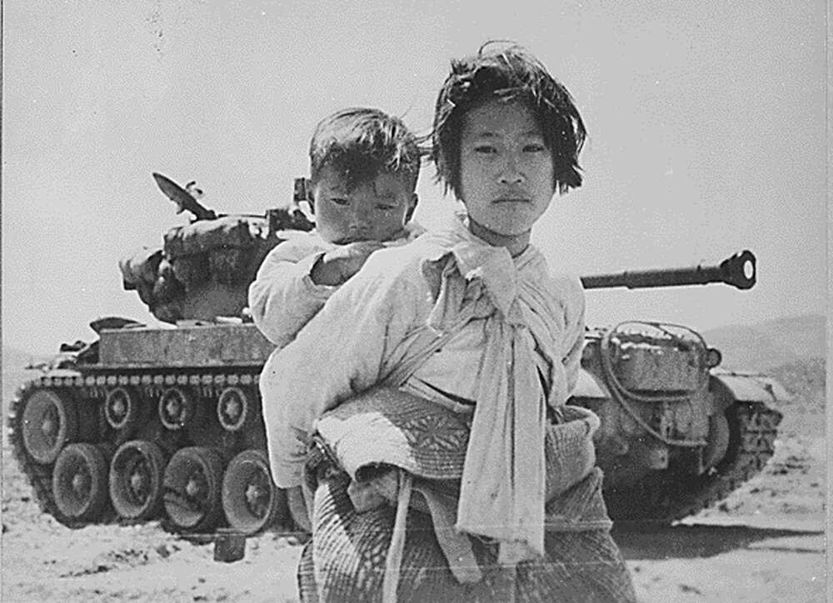
Setting
Chapter 2
Time and Place: Early-mid 1950s, Pensacola, Florida (Pete Conrad)
Historic events
WW2 ends in 1945, Korean War starts June 25, 1950
Joseph Stalin dies March 5, 1953
Warsaw Pact signed May 14, 1955
Vietnam War begins November 1, 1955
With her brother on her back a war weary Korean girl tiredly trudges by a stalled M-26 tank, at Haengju, Korea. 6/9/1951, Library of Congress
(https://www.pbs.org/wgbh/americanexperience/features/bomb-korean-war/)

Slide 8
Rising and Falling Action of the Plot - Chapter 2
Chapter starts by talking about pilots going through their flight training and the difficulties of it, focused more on the navy part, since Pete Conrad was a navy pilot. The idea of “The Right stuff” is also mentioned in this chapter.
Pilots who did not have the physical traits, failed the tests, were not as good of a pilot as others were, and even who lost their lives during training were considered by the pilots as not having “The Right Stuff”.
What is “The Right stuff”?
The ziggurat, During the wars, having combat experience was being at the top, but now, the top was flying as test pilots of new jets and rocket planes.
The chapter sets the background of the whole story.
https://youtu.be/Q2qqKwndFW0

Slide 9
Characters - Chapter 2
Pete Conrad - ex navy pilot, no combat experience, but became a test pilot. Graduated from Pax river. It is mentioned that Conrad flew for 23 years. HIs father was a philadelphia stockbroker, had a house in the Main Line Suburbs, a limo, and a chauffeur.(Rich), But the depression took everything from them. His parents divorced, and moved to Florida. Went to Princeton to learn flying.
Gus Grissom is first mentioned in this chapter, he was a Korean war veteran as an airforce pilot.

Slide 10
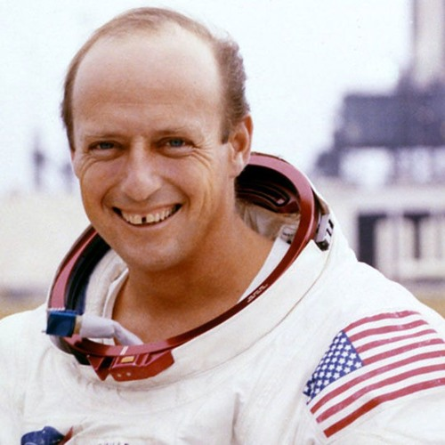
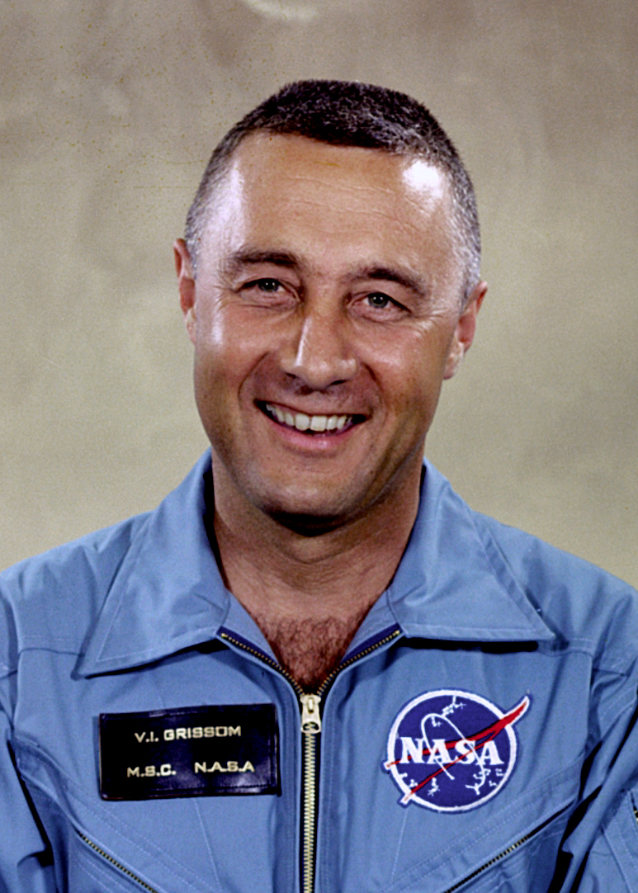
https://www.imdb.com/name/nm0342628/
https://soundcloud.com/pawprinceton/pawcast-jordan-bimm-on-the-legacy-of-astronaut-pete-conrad-53

Slide 11
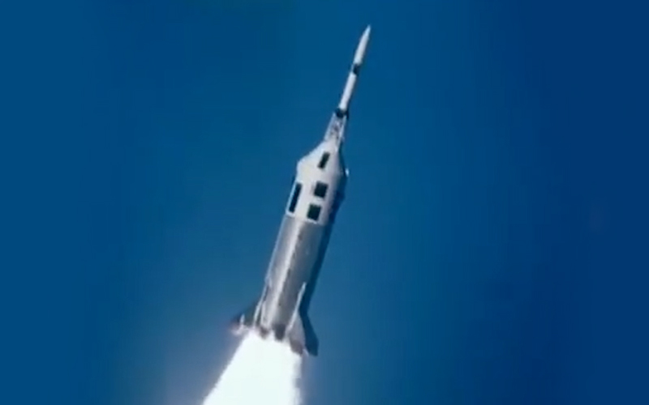
Setting
Chapter 10
TIme and Place: May 5, 1961 on Cape Canaveral in Florida.
Historic events
April 12, 1961 : Soviets successfully launch and return Yuri Gagarin
May 2, 1961 : Mercury - Atlas control system sends the rocket “Little Joe” off course
April 25, 1961 : Gus Grissom almost killed after Atlas test rocket blows up after going off course
US fails to overthrow Fidel Castro in Cuba.
Little joe rocket https://rocketrundown.com/the-successful-failure-of-the-little-joe-ii-bp-22-mission/

Slide 12
Rising and Falling Action - Chapter 10
Chapter entails the launch of the first Mercury rocket with Alan Shepard as the astronaut. - May 5, 1961, 14h 24m 13s UTC
Intense build-up during the countdown of the launch.
Flight was almost canceled and Alan Shepard almost accidentally ejected himself from the capsule.
Alan Shepard takes off into space and is constantly worrying about messing up and ruining the mission.
He successfully lands back on earth in the ocean and is greeted as a national hero.

Slide 13
Characters
Alan Shepard - The astronaut chosen to be the first American man in space. He is inside the Mercury capsule that will allow him to fulfill his mission.
Chuck Yeager - The “ace” pilot, Shepard is reminded of him when he says “light the candle” ; a phrase that Chuck Yeager was known for.
John Glenn - Fellow astronaut of Alan Shepard, technician for the Mercury rocket and personally helped Shepard train and prepare for the flight.
Louise Shepard - Alan Shepard’s wife, was not present at the launch site. Was instead at their house in Virginia Beach, and was avoiding media.

Slide 14
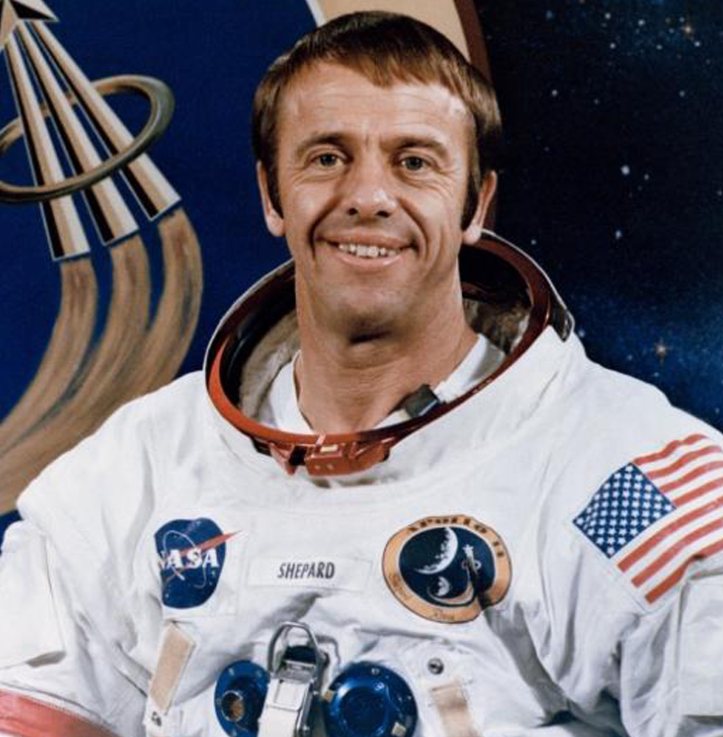
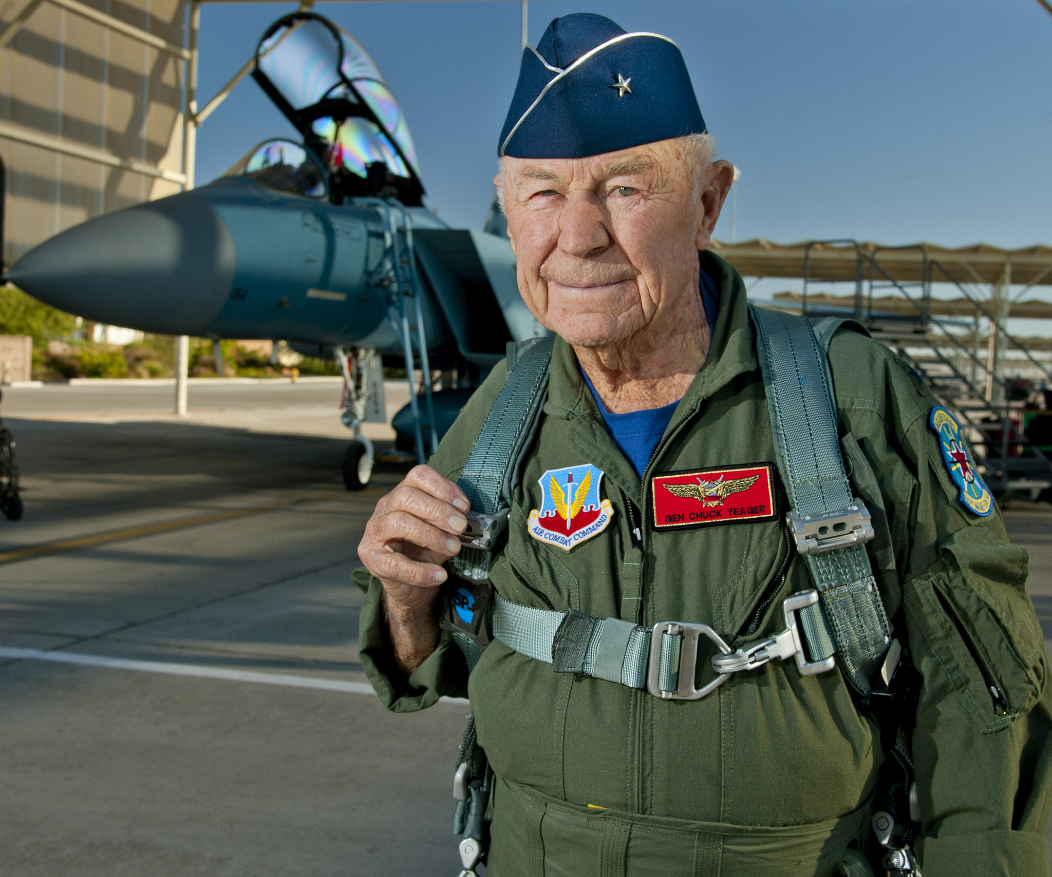
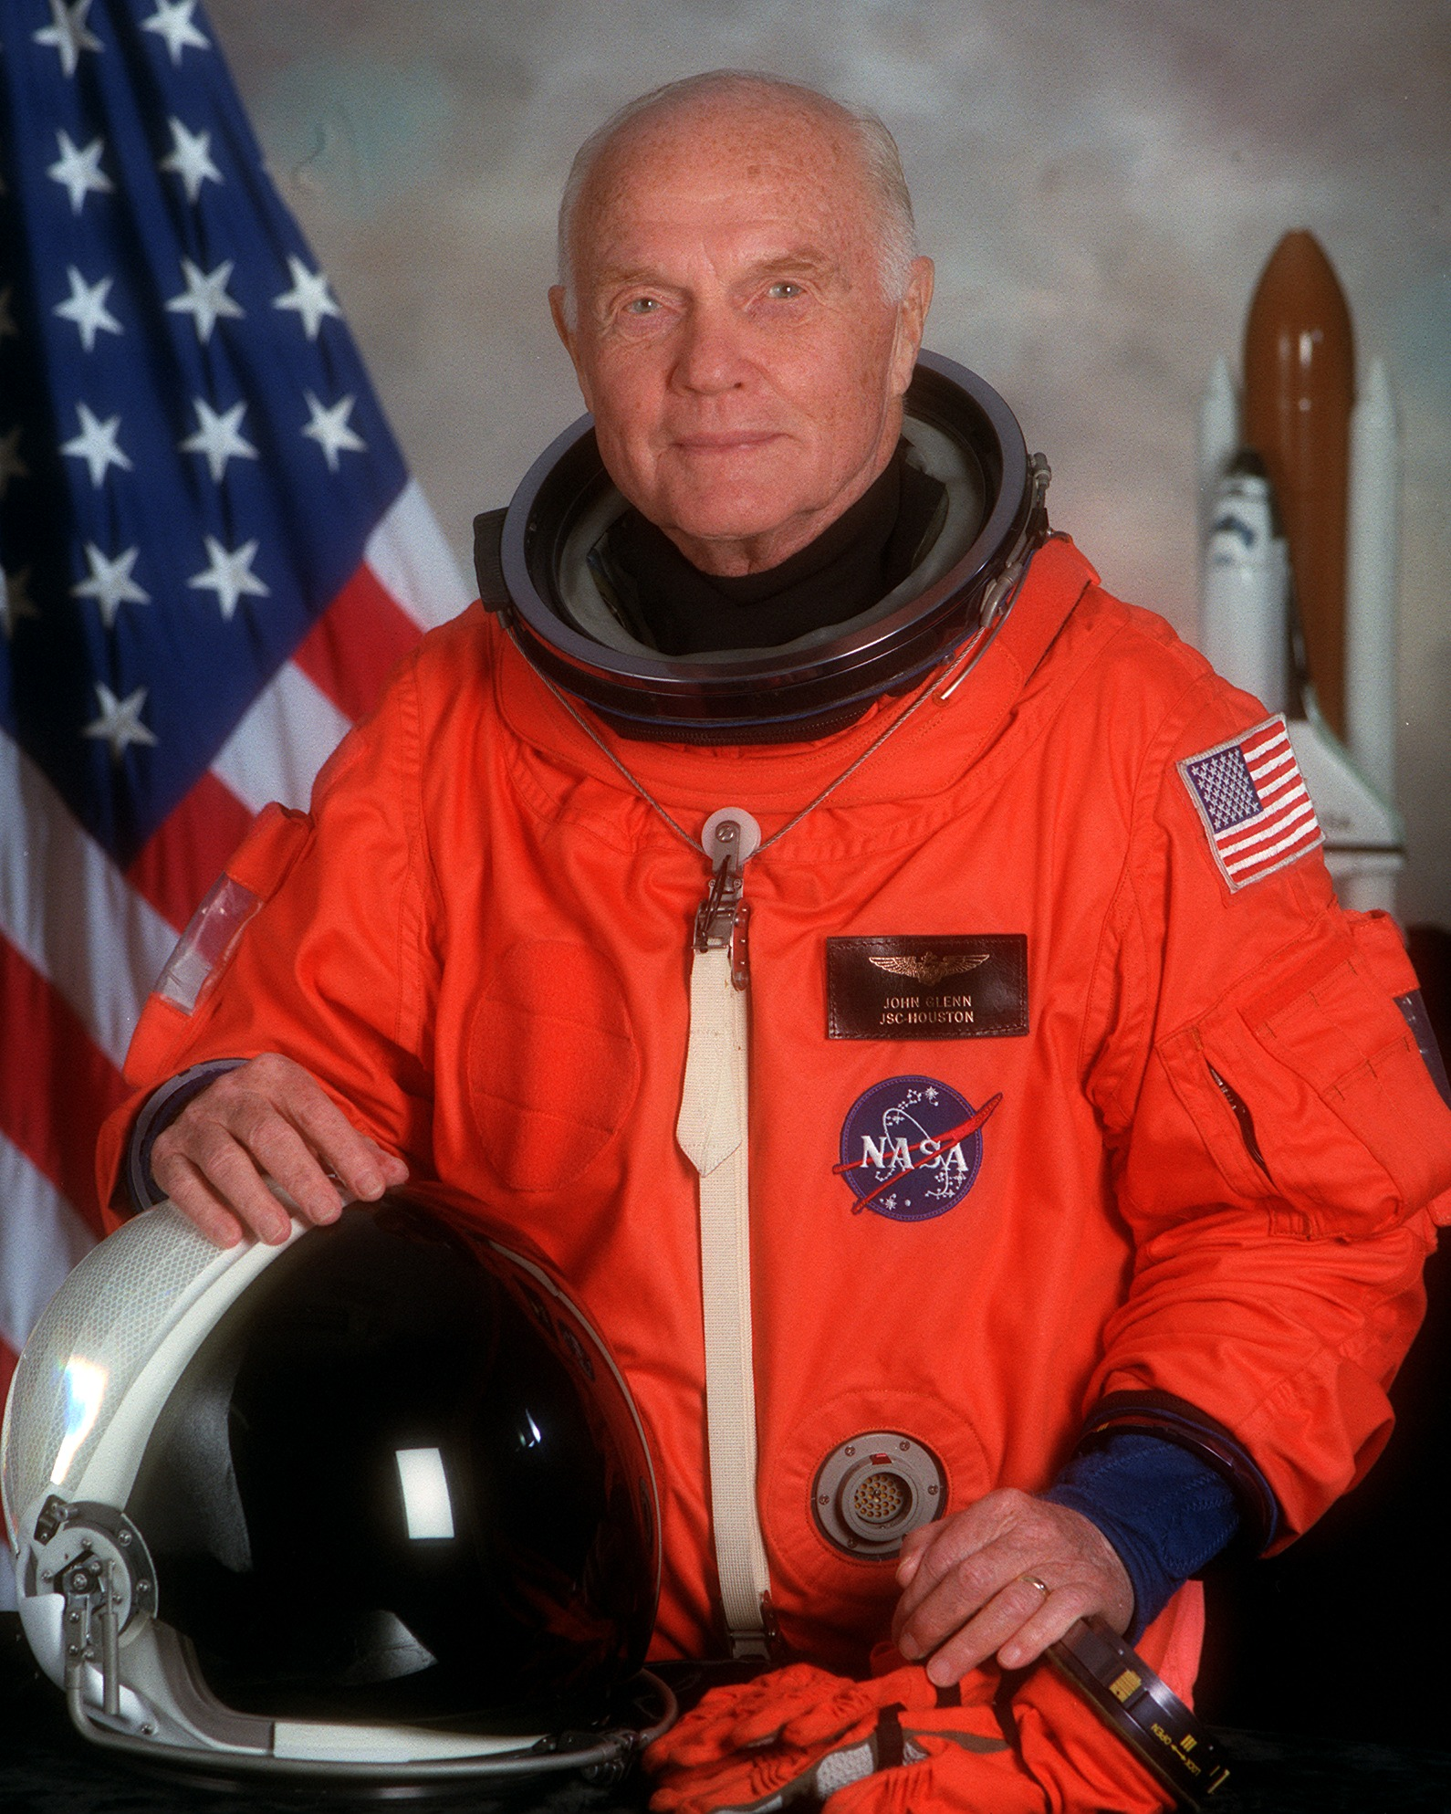
https://www.imdb.com/name/nm0791593 https://www.airforcetimes.com/news/your-air-force/2020/12/08/chuck-yeager-1st-to-break-sound-barrier-dies-at-97/
https://www.nasa.gov/centers/glenn/about/bios/shuttle_mission.html

Slide 15
Commentary
Chapter 1: The first chapter briefly shows the pilots who had the right stuff and ones who do not, and the minds of wives watching them go to dangerous flights.
Chapter 2: “A career in flying was like climbing one of those ancient Babylonian pyramids made up of a dizzy progression of steps and ledges, a ziggurat, a pyramid extraordinarily high and steep; and the idea was was to prove at every foot of the way up that pyramid that you were one of the elected and anointed ones who had the right stuff and could move higher and higher even….”
Chapter 3: “A little adulation on the order of the Pope’s; that’s all the True Brothers at the top of the pyramid really wanted.”

Slide 16
Commentary
Chapter 4: “In short he would be a passenger”. “It was then that it began to dawn on Conrad, first as a feeling rather than as a fully formed though: “Lab Rats””.
Chapter 5: “Could I ask for a show of hands of how many are confident that they will come back from outer space?”
Chapter 6: “ It was damned strange to be in flight training, as America’s first astronauts, and yet to be doing no flying themselves, except as passengers”.
Chapter 7: “... manly courage in the face of physical danger. When they met someone who had it, they wanted to establish a relationship with that righteous stuff.”

Slide 17
Commentary
Chapter 8: “At the outset it had been understood - it didn’t even require comment - that the astronauts would be just that: test subjects in an experiment.”
Chapter 10: “For a test pilot the right stuff in the prayer department was not “Please, God, don’t let me blow up.” No, the supplication at such a moment was “Please, dear God, don;t let me fuck up.”” “..being where he was right now was his vocation, his calling, , his holy Beruf. He was hime, upon the right stuff’s highest elevations.”

Slide 18
Works Cited
“Major Events of the 1950s.” TimeToast, https://www.timetoast.com/timelines/major-events-of-the-1950s--2. Accessed 27 Feb. 2022.
Wolfe, Tom. The Right Stuff. 2nd ed., Picador USA, 2008.

Slide 19
The Right Stuff Literature Circles
Chapters 2 & 10
COM 1102
Spring 2022
Junhee Jang, Jean-Pierre Derbes, Michel Haddad, Cecilia Costa

Slide 20
Commentary (Jiho Lee, Sebastian Castillo)
1.
“The Right Stuff became the story of why men are willing–willing? —delighted! —to take on such odds in this…”.
2.
“Hell, we wouldn’t give you a nickel for a pilot who hasn’t done some crazy rat-racing like that. It’s all part of the right stuff.”
3.
“...as of that time, the 1950’s, Chuck Yeager was at the top of the pyramid, number one among all the True Brothers.”

Slide 21
Commentary (Jiho Lee, Sebastian Castillo)
4.
“They had been brought to Washington, they were told, because NASA needed volunteers for suborbital and orbital flights above the earth's atmosphere in Project Mercury.”
5.
“They were risking their lives for their country, for their people, in "the fateful testing" versus the powerful Soviet Integral.”
6.
“Sure enough, NASA approved the idea, the White House approved it, and DeOrsey started getting in touch with magazines, setting $500,000 as the floor for bids. The one solid offer—$500,000—came from Life, and DeOrsey closed the deal. Life had an excellent precedent for the decision. ”

Slide 22
Commentary (Jiho Lee, Sebastian Castillo)
7.
“Glenn had one great ally among the other six, and that was Scott Carpenter. Carpenter looked up to him and backed him in the debate. Wally Schirra and Gordon Cooper tended to back Shepard, arguing that when you were on duty you should be a model of correctness, but that when you were off duty your personal life was your own lookout.”
8.
“When the boys went to Edwards for their briefings on the X-15 program and their weightless parabolas—riding backseat with Edwards pilots—they picked up a whiff of… contempt…”

Slide 23
The Right Stuff Literature Circles
Chapters 1 & 9
COM 1102
Spring 2022

Slide 24
Setting
a.time and place for this chapter
Chapter 4
In 1959
Lovelace Clinic
Chapter 11
b. World/political events concerning the Space race

Slide 25
Rising and Falling Action for the Plot
Chapter 4
In chapter four the pilots travel to Lovelace clinic to undergo medical tests to ensure that they are able to go on the rockets.

Slide 26
Characters
What is revealed by: what they said, what they do, what is said about them

Slide 27
Comments
Commentary on “right stuff” and on the theme of your group. This should not be limited to what is in your chapter but should consider all of chapters 1-8, the first reading assignment.

Slide 29
The Right Stuff Literature Circles: Honor
Chapters 5 & 12
COM 1102
Spring 2022
Brendan Ladwein, Ernie Arizzi, Richard Rathbun, Rahul Rajkumar

Slide 30
Short Passage
Chapter 5:
“Gus and the others started looking down at the table at each other, and then they all started hoisting their hands in the air. It really made you feel like an idiot, raising you hand this way. If you didn’t think you were ‘coming back,’ then you would really have to be a fool or a nut to have volunteered at all.” (Wolfe 93)
Chapter 12:
“That was what the sight of John Glenn did to Americans at that time. It primed them for the tears. And those tears ran like a river all over America. It was an extraordinary thing, being the sort of mortal who brought tears to other men’s eyes.” (Wolfe 282)

Slide 31
Setting
Chapter 5:
The Dolly Madison House, just a few hundred yards from the White House.
NASA’s Washington headquarters
Astronaut volunteers are being interviewed after they had been selected by NASA.
Phoenix, Arizona. A quick interview with Chuck Yeager.
Chapter 12:
The rising action takes place on April 12, 1961 out of Baikonur.
The climax of this chapter takes place on February 20, 1962 in Cape Canaveral.
The falling action takes place in the streets of NY city.

Slide 32
Rising & Falling Action
Chapter 5:
The astronaut candidates are being interviewed by the media to see what they can gather from the brave heroes. But they ask questions that surprise all but John Glenn who answers them all back with his halo turned on. When asked how many of them will “come back,” they all raise their hands in response.
At the end of the chapter, it is discovered that no man will be the first into space, but rather a monkey.
Chapter 12:
The rising action from this chapter is the moments leading up to Glenn’s launch. There’s a common figure that every manned space launch has a 26% chance of fatality, and there were major stakes on this launch. The russians had just beat us to space, so we needed a success to help boost American morale.The falling action was the moments after the launch, where NYPD officers were crying tears of joy in the streets. This moment was said to be the largest time of nationwide unity and celebration since the end of WWII.

Slide 33
Characters
Chapter 5:
Gus Grissom
Malcolm Carpenter
John Glenn
Walter Shirra
Donald Slayton
Leroy Cooper
Alan Shepard
Chapter 12:
~ Yuri Gagarin: The first man in space. When Yuri broke orbit in 1961, this was considered a big loss for America. The russians had beat us to space. We had a come back in the following years by putting the first man on the moon, but this initial loss was still quite devastating.
~ Bob White: White was a pilot that flew the X-15. He flew nearly as high as the other pilots, using rockets nearly as big flying nearly as fast, is weightless nearly as long and all of this in a manned, piloted flight. The press however, ignored these accomplishments.
~ John Glenn: John Glenn was the first American to orbit the Earth. He made his voyage in 1962, shortly after Gagarin. In chapter 12 Nasa announces him as the pilot for this mission.

Slide 34
Commentary & Theme
Chapter 5:
Throughout chapter 5 the theme of honor is generated substantially because of how the astronauts are filled with honor by the press as the are presented as heroes to the general public as outstanding people and as those who would dare to do the impossible. After surviving having their pride hurt during the tests before, having the main stage and showing the United States how great they are and the thing that they are going to accomplish boost their honor to another height.
Chapter 12:
It’s easy to be honorable when you are succeeding, but the true test of character is maintaining honor after a big loss. When the Russians won the space race, this was a true test of honor and integrity for the American space program. It would have been easy to accept defeat and hang their heads, but NASA decided to press on. Just a few short months later they responded by putting John Glenn on a rocket and having him orbit the globe three times before landing back on American soil. This helped Americans reclaim their honor, and inspired them to aim all the way to the moon!

Slide 35
Works Cited
Wolfe, Tom. The Right Stuff. New York: Farrar, Straus, and Giroux, 1979. Print.

Slide 36
The Right Stuff Literature Circles: Patriotism
Chapters 6 & 13
COM 1102
Spring 2022

Slide 37
Group Members:
Drake Johnson (Setting)
Emily Martin (Rising/Falling Action)
Cade Miles (Characters Chapter 6)
Chris Nederhoed (Characters Chapter 13)
T.J. Boylan (Commentary/Theme)

Slide 38
Short Passage
Chapter 6:
From the very beginning this "astronaut" business was just an unbelievable good deal. It was such a good deal that it seemed like tempting fate for an astronaut to call himself an astronaut, even though that was the official job description. You didn't even refer to the others as astronauts. You'd never say something such as "I'll take that up with the other astronauts."You'd say, "I'll take that up with the other fellows" or "the other pilots." Somehow calling yourself an "astronaut" was like a combat ace going around describing his occupation as "combatace."This thing was such an unbelievable good deal, it was as if "astronaut" were an honorific, like "champion" or "superstar," as if the word itself were one of the infinite variety of goodies that Project Mercury was bringing your way.
Chapter 13:
By now, three months after his flight, John had ascended to a status that only a biblical scholar could fully appreciate. John was the triumphant single-combat warrior. He had risked his life to challenge the mighty Soviet Integral on the high ground. Through his skill and courage he had neutralized the enemy’s advantage, and the tears of joy and gratitude and awe still flowed. (Wolfe 291)

Slide 39
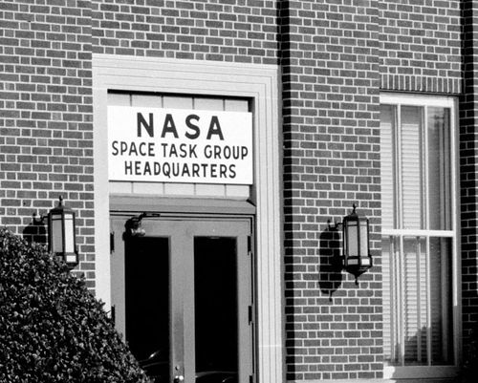
Setting: Chapter 6 (102-126)
Drake Johnson
Time and Location:
1959
Primarily in Langley, Virginia, at the ‘Nasa headquarters for the Space Task Group for Project Mercury’
Space Race Events:
First Titan Missiles tested and launched. Later versions would be used by the Gemini Program
April, NASA announces the Mercury 7.
NASA Jupiter AM-18 mission sees first successful return of living animals from space, including two squirrel monkeys
Several satellites launched by the US
Soviets complete first Moon flyby and solar orbit missions
NASA Pioneer IV Misses the moon, and becomes second satellite in orbit of the Sun
First X-15 test flight
Also Happening:
Alaska and Hawaii admitted as the 49th and 50th states
Fidel Castro becomes leader of Cuba
“Day the Music Died”, several prominent musical artists killed in plane crash

Slide 40
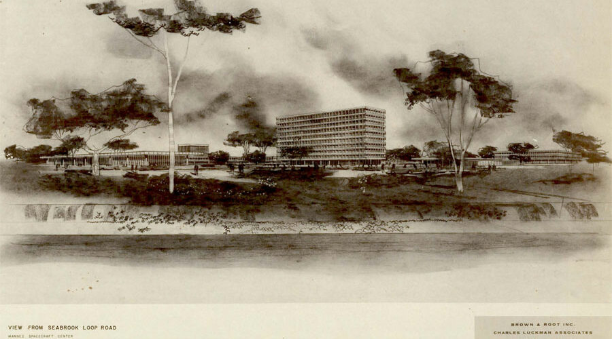
Setting: Chapter 13 (283-311)
Drake Johnson
Time and Location:
1962
Houston, Texas at the NASA Manned Space Center
Cape Canaveral and Cocoa Beach
Scott Carpenter’s Flight
Space Race Events:
NASA Landers, Ranger 3 and 5 Missions miss the Moon, Ranger 4 crashes into far side of the Moon
Neil Armstrong sets several altitude records for the X-15
NASA Mariner I was launched but was destroyed within seconds of launch because of missing hyphen in its code
NASA astronauts Glen, Carpenter, and Schirra orbit the Earth
"We choose to go to the Moon" Speech
Soviet Vostok 3 and 4 become first manned spacecraft to be in space at the same time, and to see and communicate with each other
British Ariel 1 becomes first satellite not owned by US or USSR.
Also Happening:
Cuban Missile Crisis
Jackie Robinson elected to the Baseball Hall of Fame
Global population reaches 3 Billion
Marilyn Monroe dies of an overdose
US Starfish Prime high-altitude nuclear test disables several satellites in orbit, including Ariel 1

Slide 41
Rising/Falling Action
Chapter 6 “On the Balcony”
This chapter focuses on the Mercury 7 adapting to their life in the spotlight. Many of the guys spend their nights drinking and partying. At a p.r. event for the astronauts, Gus Grissom makes the comment, “Well… do good work!” This makes the crowd go wild. With all this publicity, NASA partners with Life Magazine to market all the achievements and explorations of the astronauts. The Mercury 7 are still preparing for their trip and are all advised to work out at least 4 hours per week, however, only Glenn follows this. This makes Glenn stick out in this chapter since it is evident that he is very serious about this opportunity. Lastly, while all the astronauts enjoying their new lives, many of them miss being a pilot and being able to fly.
Chapter 13 “The Operational Stuff”
This chapter begins with the Mercury 7 team moving to Houston, Texas. There, they make several public appearances; most notable being a welcome parade and a cocktail party. Deke Slayton is diagnosed with Idiopathic Atrial Fibrillation, a heart condition involving an irregular heartbeat, and NASA decides to remove him from any future flights. This is important since Deke no longer has “the right stuff.” Although Deke cannot fly, the others continue to. Scott was on a four-orbit flight when he realized he was extremely low on fuel. NASA lost connection with him, and the world believed him to be dead. After a lot of panic, they found him alive. Next, Carpenter went up, and experienced the same issue as Scott, low fuel. Carpenter was only on this third orbit but panicked and mishandled re-entry. Close calls with death only motivated the astronauts more, and soon after Wally Schirra decided it was his turn. His goal was to conserve fuel and complete six orbits. In his capsule, named “Sigma 7,” Wally was successfully able to conserve fuel and land properly.

Slide 42
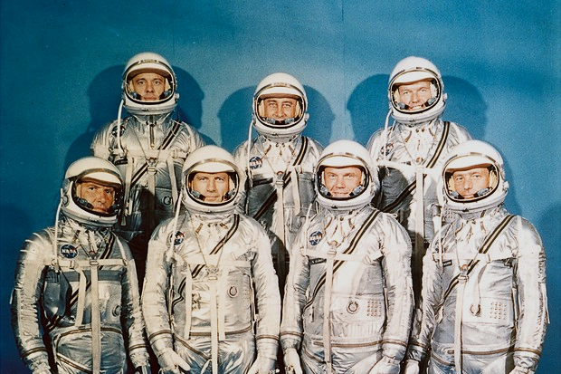
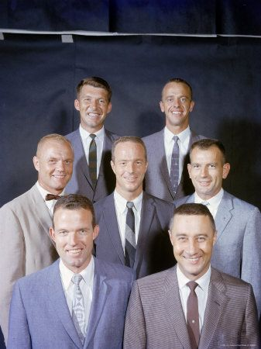
Characters
Chapter 6
On The Balcony
This chapter covers general characteristics and background of the Mercury 7.
John Glenn is described as a “good Prebyterian” and the chapter goes over many details of his upbringing in the faith. It also describes that Glenn has an “advantage over the other six” because he had a Marine flying record. The chapter also extensively covers Glenn’s experience such as his time in Korea shooting down “three MiGs” as well as his time at Pax River. The main thing the chapter covers about Glenn is how he was “ready to be the first to go into the heavens.”
Gordon Cooper is described as being a “thin, apparently guileless soul.” Cooper is described as the youngest and had never seen combat. The chapter also gives the detail that Cooper was in the Air Force with Gus Grissom and Deke Slayton. The chapter also details his complaint in the interview with the Star about not getting flight pay and having to fly commercial.
Gus Grissom is described as more publicly reserved than the rest. The chapter goes into Grissom’s “few words” at the Convair plant, being “Well…do good work!” Grissom’s relationship with Slayton is also heavily covered, and goes into detail about their friendship and how even on weekends off, Grissom would “somehow wander over to Deke’s house”.
Deke Slayton is described as “sharp” and “intelligent” especially when the subject was flying. But just like Grissom, he was impatient. The chapter goes into Slayton's background as well, including his start in the Second World War. The chapter also goes into Slayton’s dialect, Army Creole, and how he suppressed it when talking publicly.
Al Shepard is described as “the service aristocracy” because his father was a career officer. Most of the coverage of Shepard is comparing him to Schirra. Both Shepard and Schirra were Naval Academy men.
Wally Schirra is described as also being service aristocracy. His father was a civil engineer for the airforce. Both Schirra and Shepard came from a “small town” but could “handle themselves in public.”
Scott Carpenter is described as being “no further up the great ziggurat of flying” than Cooper. Carpenter was in the Navy, but “wasn’t an Academy man” like Shepard and Schirra. He is said to have been “Mr. Charm himself” knowing “how to turn on the party manners.” Just like Shepard and Schirra, Carpenter is described as small town, but could still handle himself publicly.

Slide 43
Characters
CHAPTER 13
Scott Carpenter did an orbital flight on May 24, 1962.
Wally Schirra conducted one only a few months later on October 3, 1962.
John Glenn convinces President Kennedy that the LIFE magazine deal does not unfairly benefit them over the other military personnel.
Carpenter and Schirra's flights are different views for how the program should proceed.

Slide 44
Commentary/Theme
Who has The “right stuff”
Chapter 6:
In chapter 6 John Glenn demonstrated that he did not have the right stuff because he was irritated by Scott Carpenter, people who have the right stuff do not get irritated easily over other’s achievements or actions.
Chapter 13:
By the course of the book once chapter 13 hits, John Glenn proves that he has the right stuff because of his missions that he flew and the twenty years he had spent in the marines, byt that time John has a mental progression that gave him the right stuff, allowing for his leadership and mentality to change.

Slide 45
Works Cited
Wolfe, Tom. The Right Stuff. ISHI Press International, 2020.

Slide 46
The Right Stuff Literature Circles
Chapters 4 & 11
COM 1102 Dylan Gore, Antonio Gonzalez, David Beus-Parr
Spring 2022 Preston Piszel, and Alexandra Garcia

Slide 47
Settings for CH4 & CH11
Chapter 4:
-Time: Late 1950s
-Place: Cape Canaveral, FL; Pentagon; Pax River; Lovelace Clinic;
-Current Events: Group 20 finished flight training; Prototype rockets kept blowing up
Chapter 11:
-Time: 1970s
-Place: Florida, New Hampshire, New York, Washington DC; Gus Grissom’s capsule
-Current Events: Budget approval for NASA; Bay of Pigs Invasion; Gus Grissom lost his capsule;

Slide 48
Rising and Falling Action
Chapter 4
Rising Action:
Pete Conrad's Group 20, including Wally Schirra and Jim Lovell, after just finishing their flight-test training, half of them receive orders marked "top secret," ordering them to report to a certain room at the Pentagon dressed as civilians. When they arrive they realize it is a gathering of test pilots from all over the country.
Falling Action:
Conrad reveals the letter from NASA indicated he was not chosen as one of the seven final candidates or even the 12 which included reserves

Slide 49
Rising and Falling Action (cont.)
Chapter 11
Rising Action:
Grissom realizes he lost the capsule, looking for redeemer, Cox in 2nd helo, pulled him up, Grissom looked bad.
Falling Action
Fighter Jocks say “a broad stroke of vagueness” is the way to go to explain what you would immediately fire for; NASA’s space program and JFK’s New Frontier was at risk so the mess up was kept quiet. Note: ¾ of what fighter pilots would get in trouble for, space pilots were off the hook.

Slide 50
Characters in CH4 & CH11
Chapter 4:
-Wally Schirra
-Pete Conrad
-Jim Lovell
Chapter 11:
-Alan Shepard
-President Kennedy
-Jackie Kennedy

Slide 51
Commentary
The “right stuff” for the pilots is about having the skill to do increasingly dangerous missions and coming out of them alright. The pilots knew that “the idea was to prove at every foot of the way up that pyramid that you were one of the elected and anointed ones who had the right stuff“(Wolfe 44). One way pilots would prove to themselves and others that they had the “right stuff” was by looking for glory, by being the first to do something or become the best.
Chapter 1: “The commotion at the field was over one of the most extraordinary things that even veterans pilots had ever seen at Pax River” (Wolfe 13).
Chapter 2: “Every evening at bases all over America, there were military pilots huddled in officers in officers clubs eagerly cutting the right stuff up in coded slices so they could talk about it” (Wolfe 23).

Slide 52
Commentary
Chapter 3: “As of 1948, after Yeager's flight was made public, every hot pilot in the country knew that Muroc was what you aimed for if you wanted to reach the top.” (Wolfe 48)
Chapter 4: “...you had been routinely risking your life and were so used to it, had such righteous stuff, that riding a rocket seemed like a vacation by comparison” (Wolfe 174). This states how in an attempt to get the glory of being the first man in space these pilots emphasize that they risk their lives, thus that they have the right stuff.

Slide 53
Commentary (cont.)
Chapter 5: “Two of the Navy guys, Shepard and Schirra, were good experienced test pilots, solid men, even though neither had done anything to make anybody's mouth fall open at Edwards.” (Wolfe 101)
Chapter 6: “Scott Carpenter was a case in point. He was open and forthright by nature, and he happened to tell one of the Life writers how his teenage years had been anything but standard-issue astronaut-corps…” (Wolfe 125)
Chapter 7: “Glenn and Carpenter were even willing guinea pigs for the two psychiatrists who had just come on board, Sheldon Korchin from the University of California and George Ruff, who had been in charge of the psychiatric testing at Wright-Pat.” (Wolfe 138)
Chapter 8: “On May 7 Walker had cut loose the X-15 on its first realspeed runwith the Little Engine and reached Mach 3.19 or 2,111 miles an hour, just a shade faster than MelApt's world record of 2,094 miles an hour in the X-2.” (Wolfe 160)

Slide 54
Works Cited
Wolfe, Tom. The Right Stuff. Picador, https://drive.google.com/drive/u/1/my-drive.

